Slide 1

IAM
Sameer zulfi

Slide 2
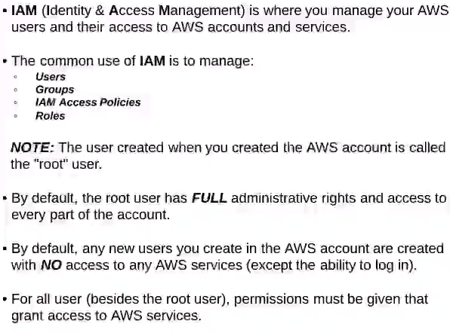
What is IAM ?
Root Account created by default, shouldn’t be used or shared
Groups only contain users, not other groups

Slide 3
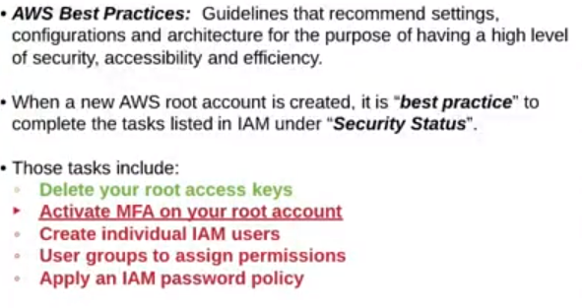
IAM initial Configuration

Slide 4
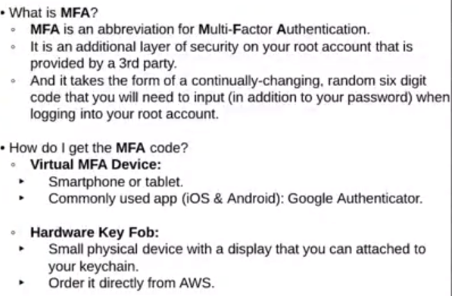
Activate MFA on your root account

Slide 5
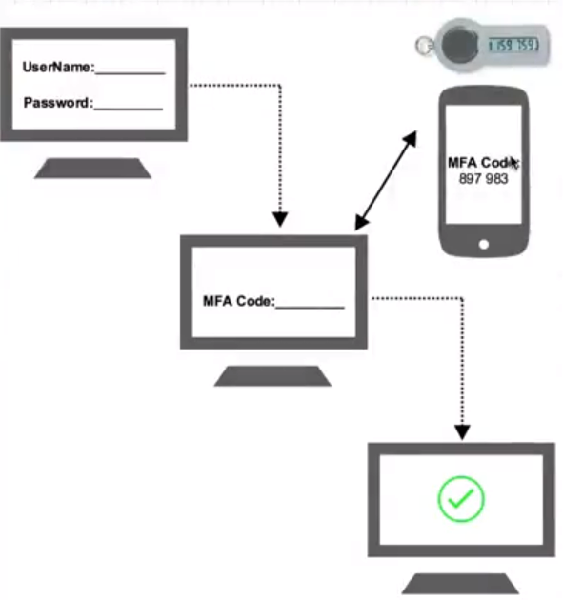

Slide 6
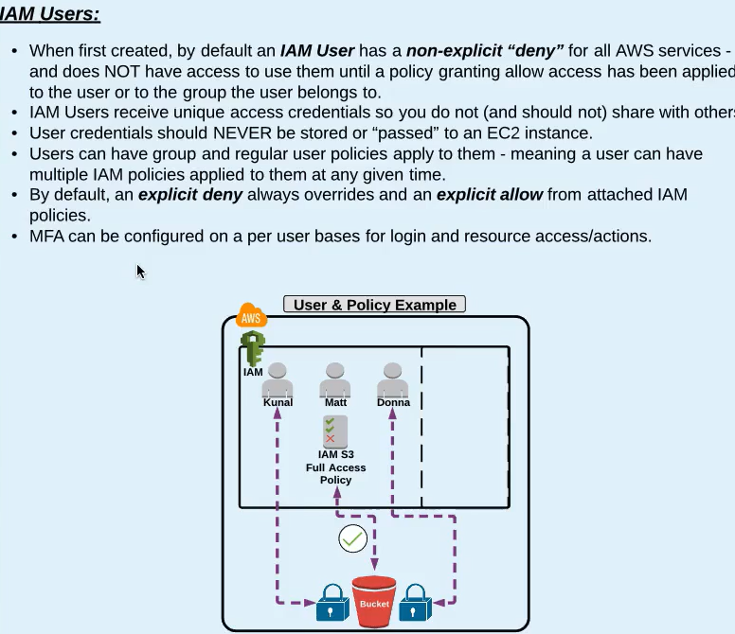
IAM Users

Slide 7
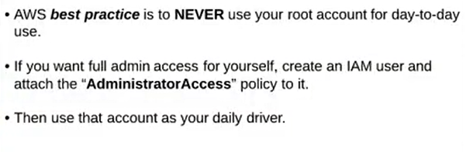
Create Individual Users

Slide 8
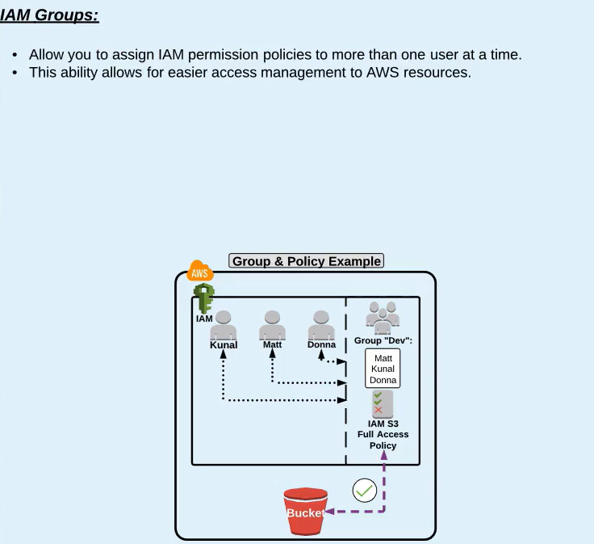
IAM Groups

Slide 9
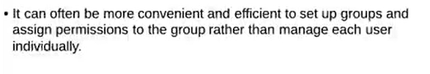
Create Groups

Slide 10
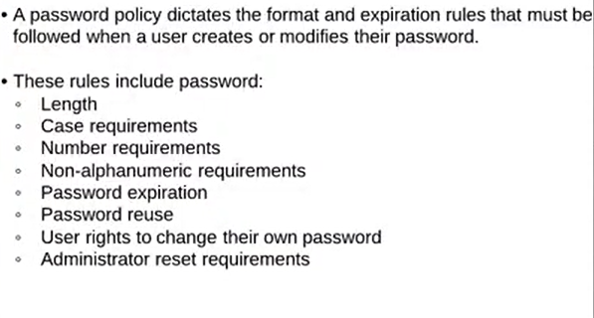
Apply IAM Password Policy

Slide 11
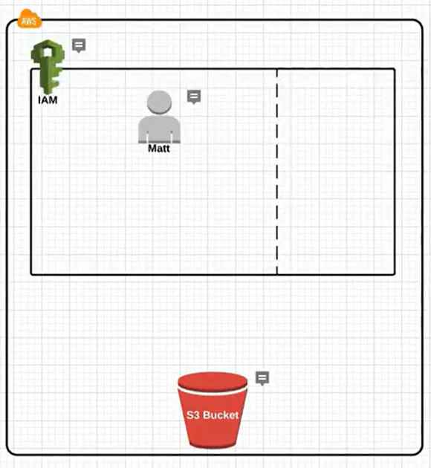

Slide 12
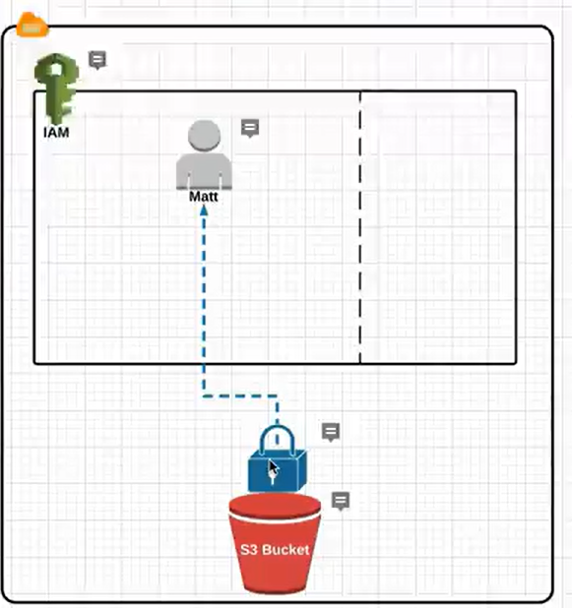

Slide 13
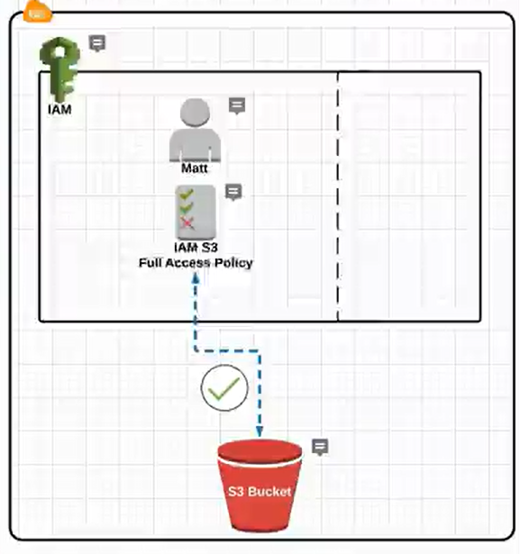

Slide 14
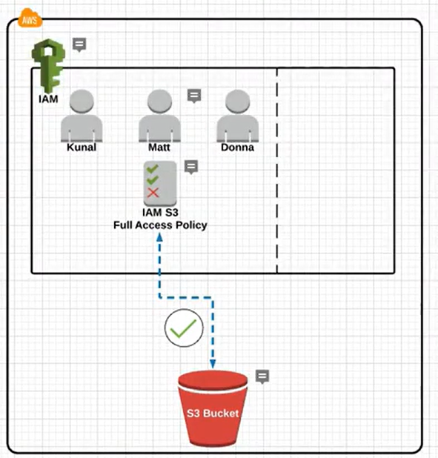

Slide 15
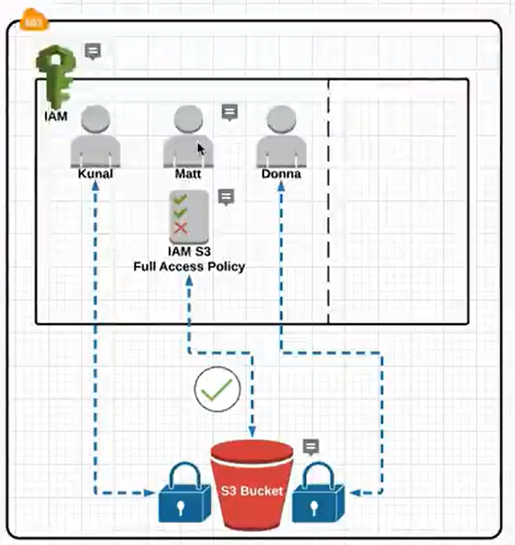

Slide 16
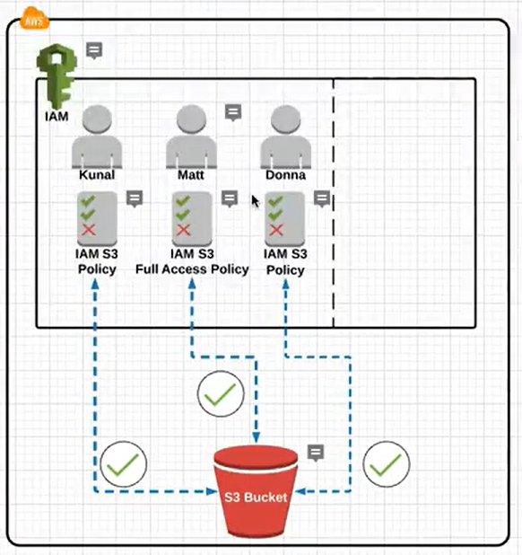

Slide 17
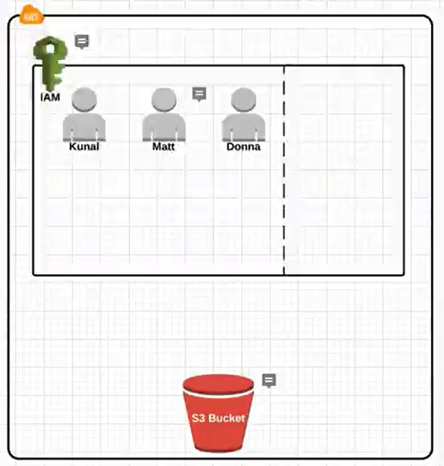
IAM Groups and Policies

Slide 18
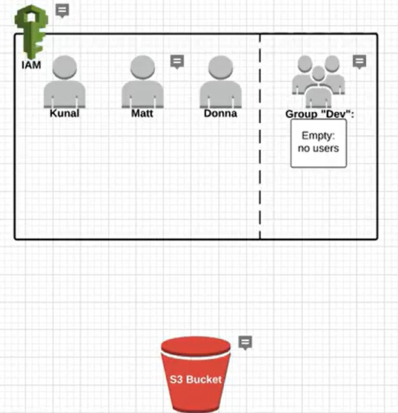

Slide 19
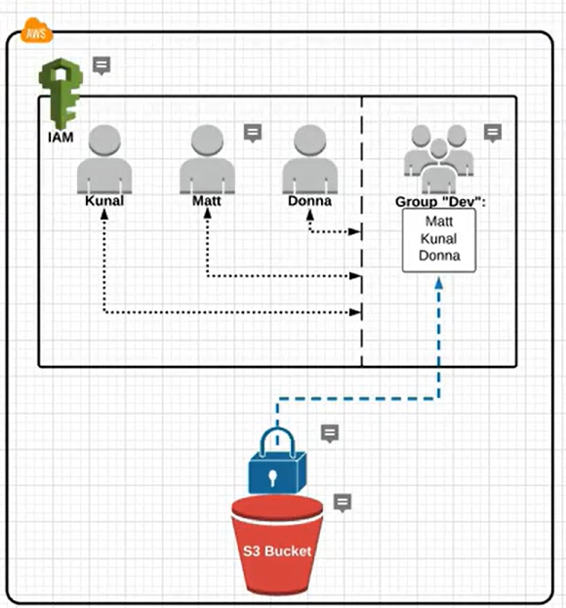

Slide 20
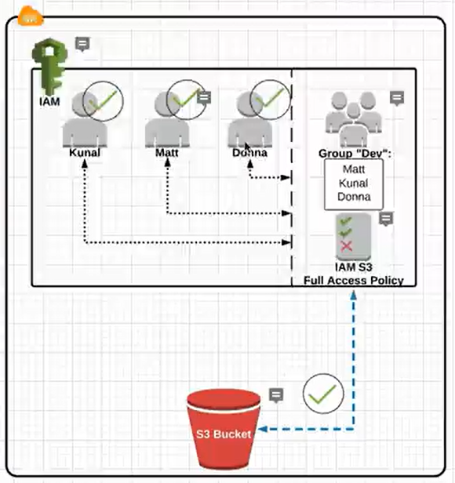

Slide 21
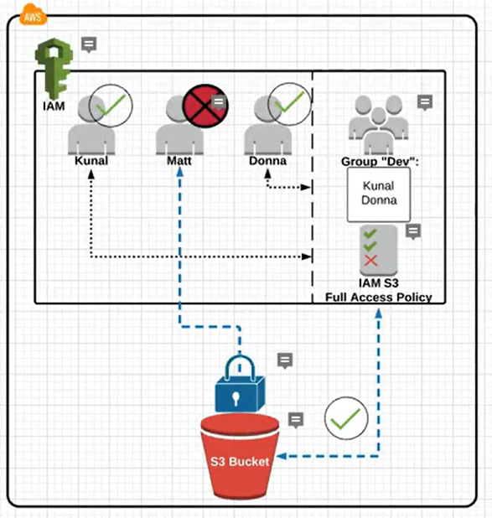

Slide 22
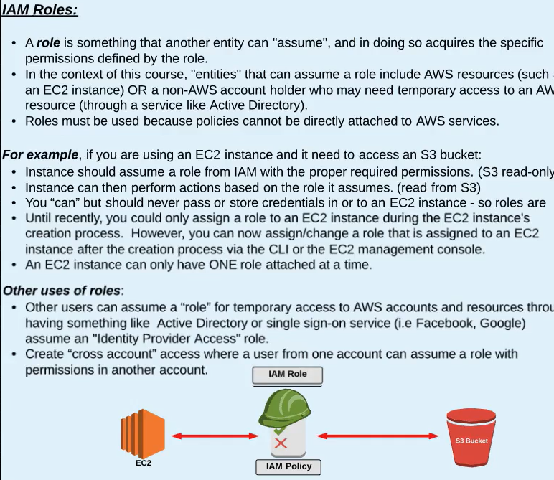
IAM Roles

Slide 23
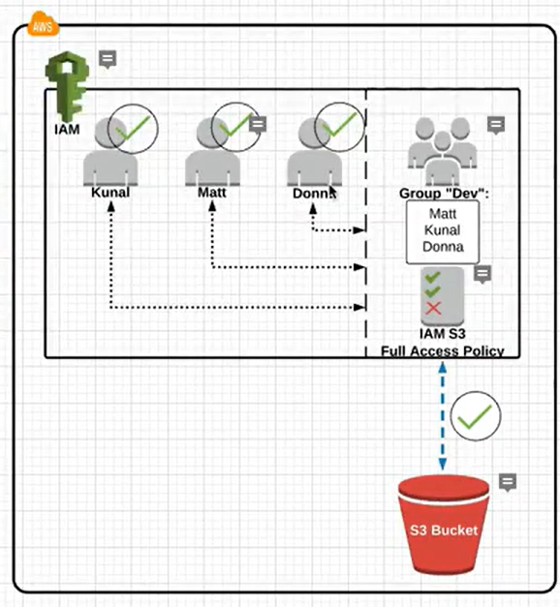
IAM Roles

Slide 24
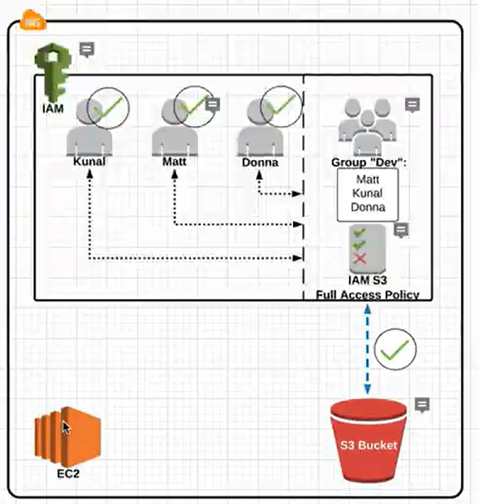

Slide 25
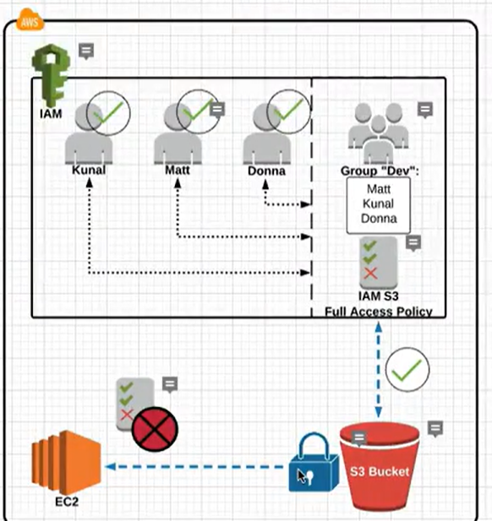

Slide 26
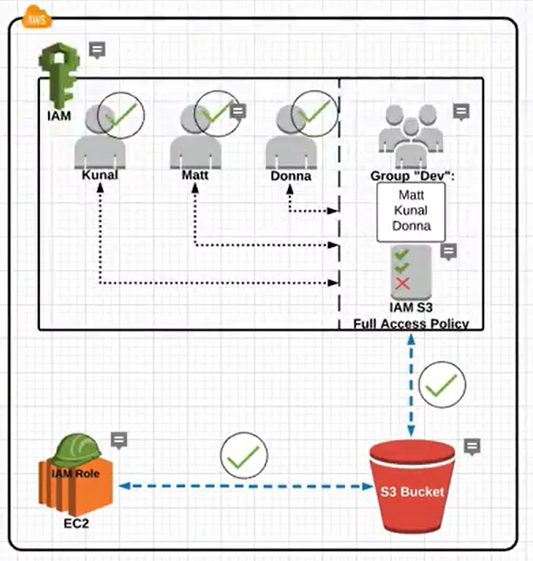

Slide 27
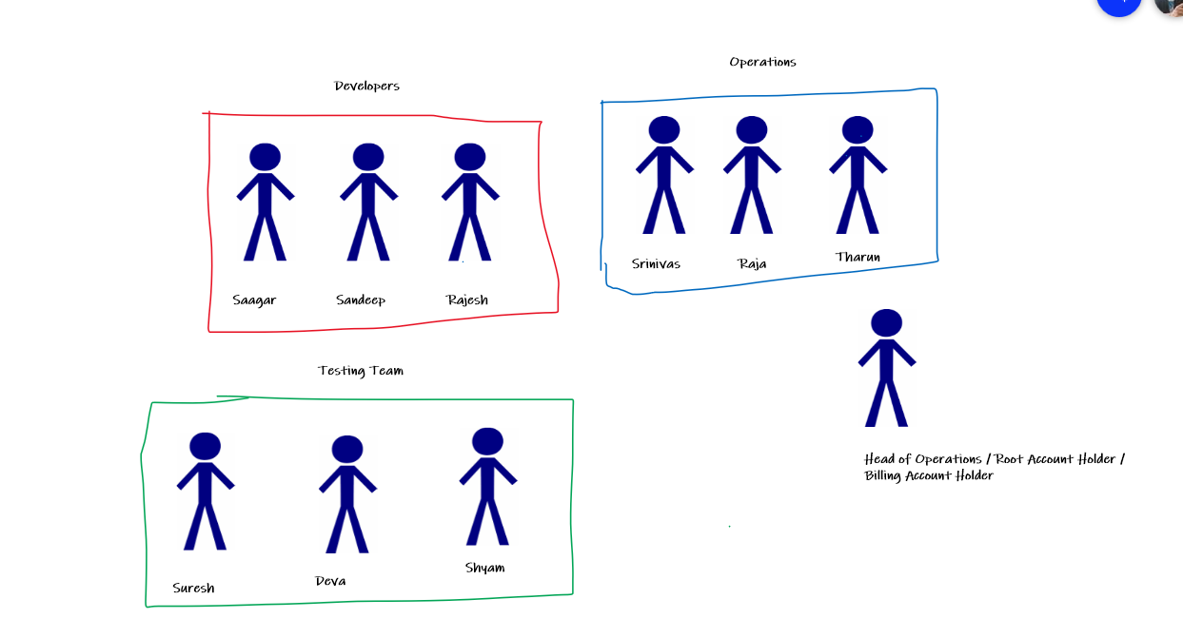

Slide 28
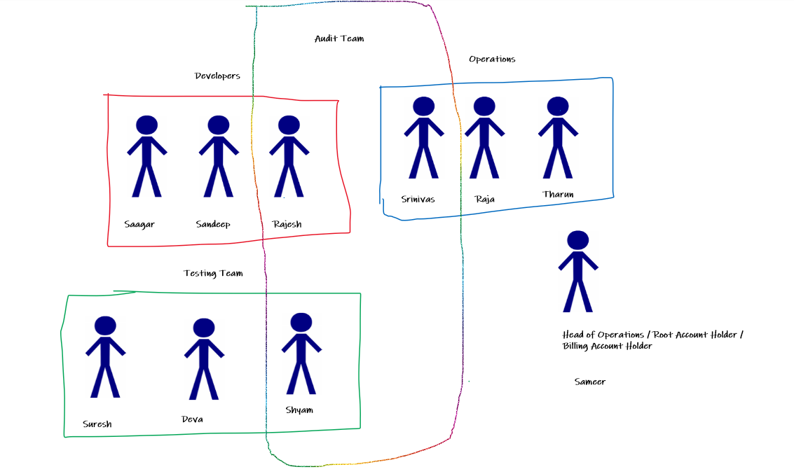

Slide 29
IAM Permissions

Slide 30
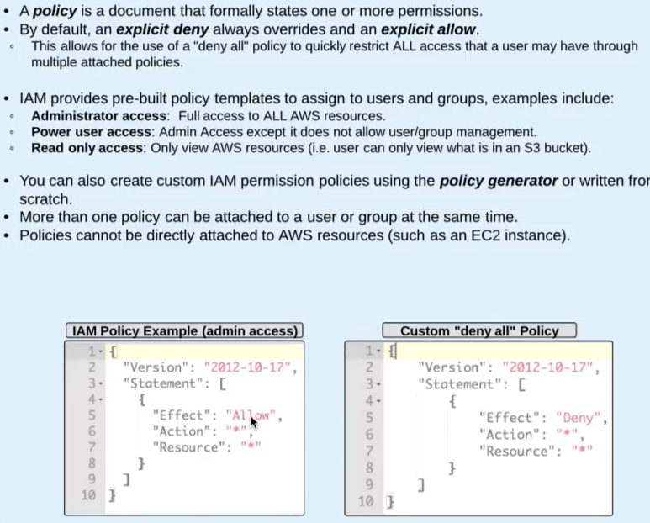
IAM Policies

Slide 31
Some Tasks
Give Admin Access to one User and take that off
Give IAM read only access to one user and take that off
Create a group and add some policies directly and also add some groups

Slide 32
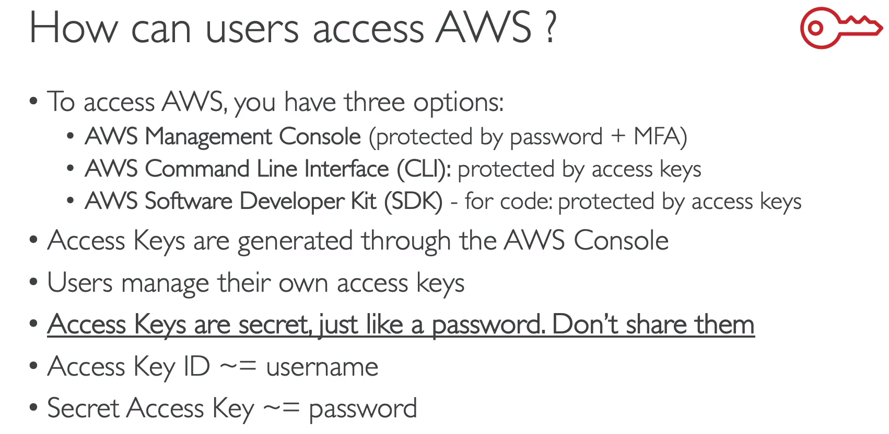
How can users access AWS?

Slide 33
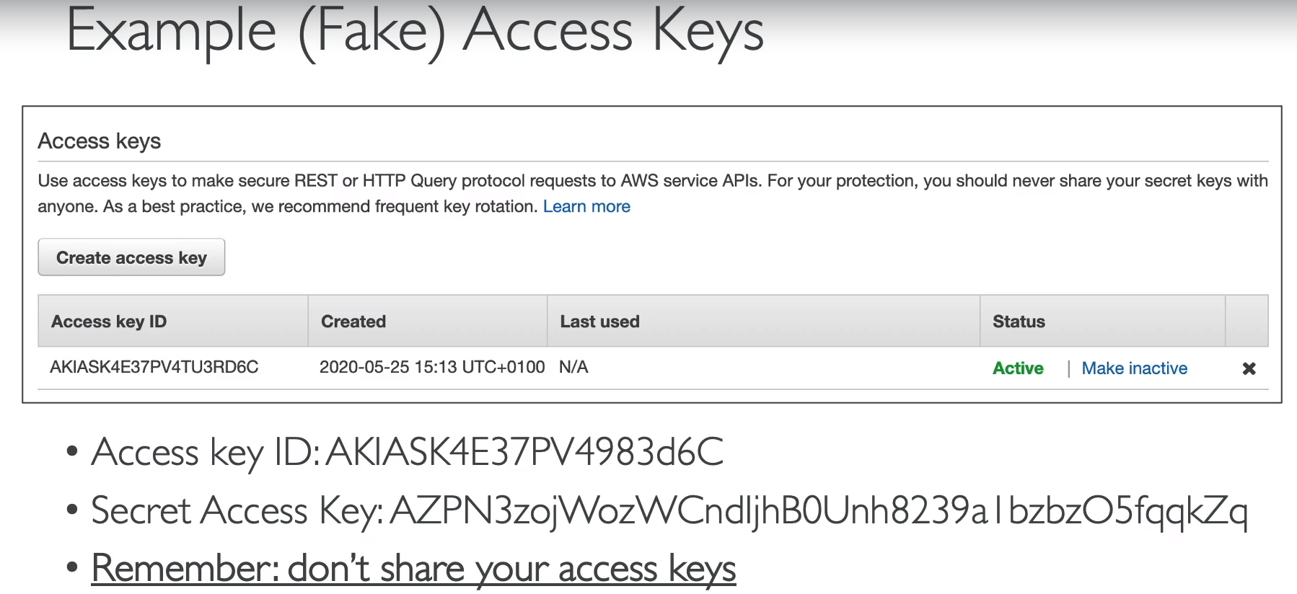

Slide 34
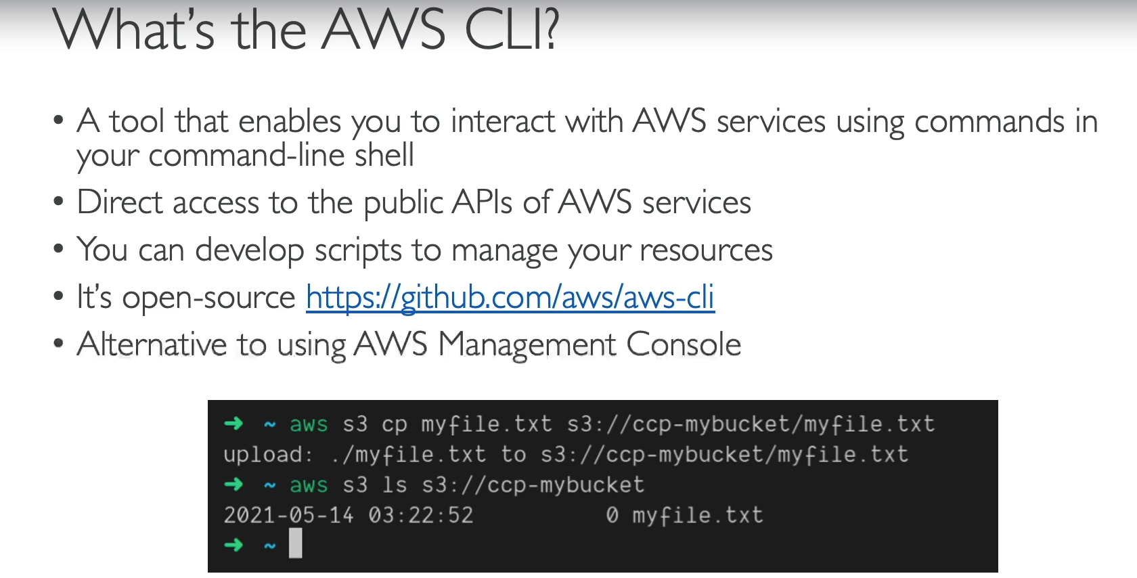
What is AWS CLI?

Slide 35
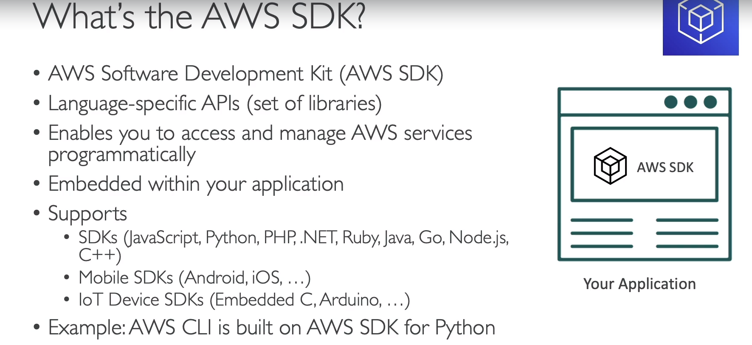
What is AWS SDK?

Slide 36
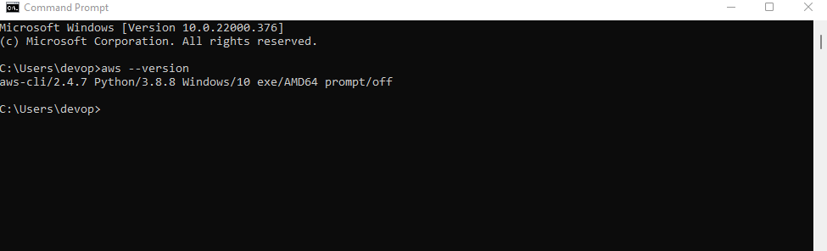
How to install AWS CLI on Windows
url - https://awscli.amazonaws.com/AWSCLIV2.msi

Slide 37
Few Tasks
Create Access Keys for one User
Run the downloaded Access Key from Command Prompt from your Laptop
aws configure
Aws iam list-users

Slide 38
AWS CloudShell

Slide 39
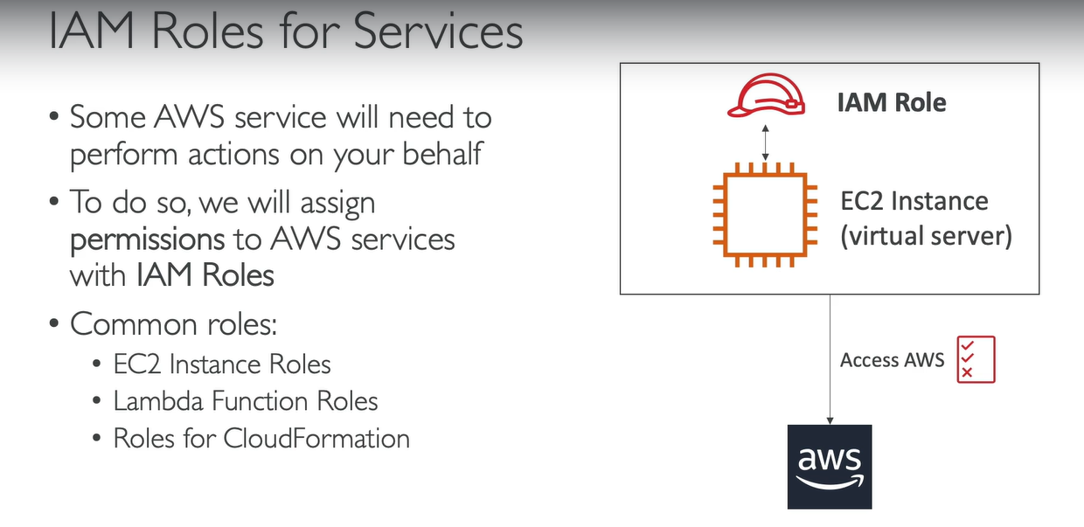
IAM Roles again in detail for Services

Slide 40
Few Tasks
Create a role with iam read only access permission access

Slide 41
IAM Security Tools
IAM Credential Report (account-level)
IAM Access Advisor (user-level)

Slide 42
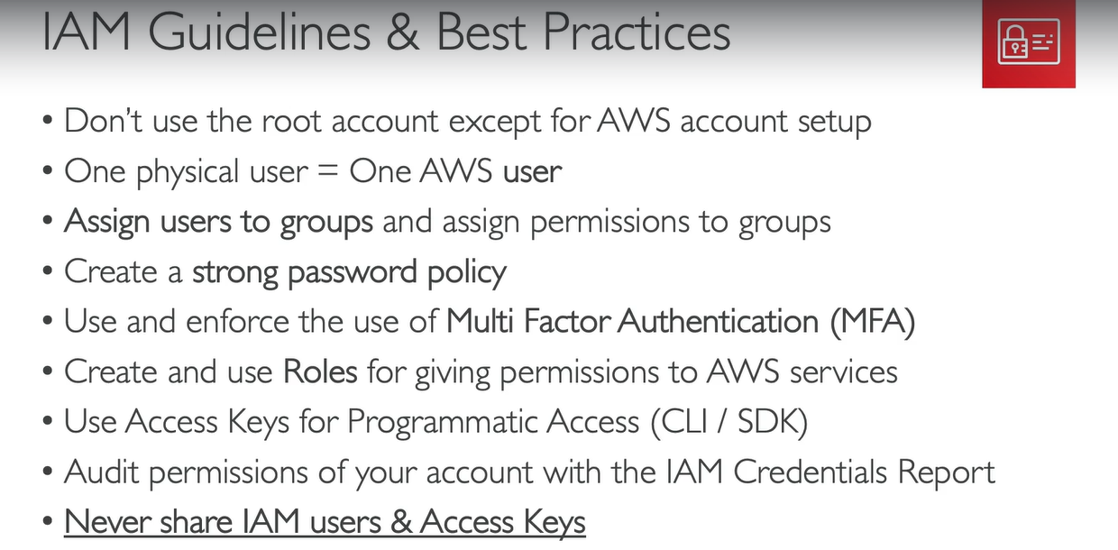
IAM Best Practices

Slide 43
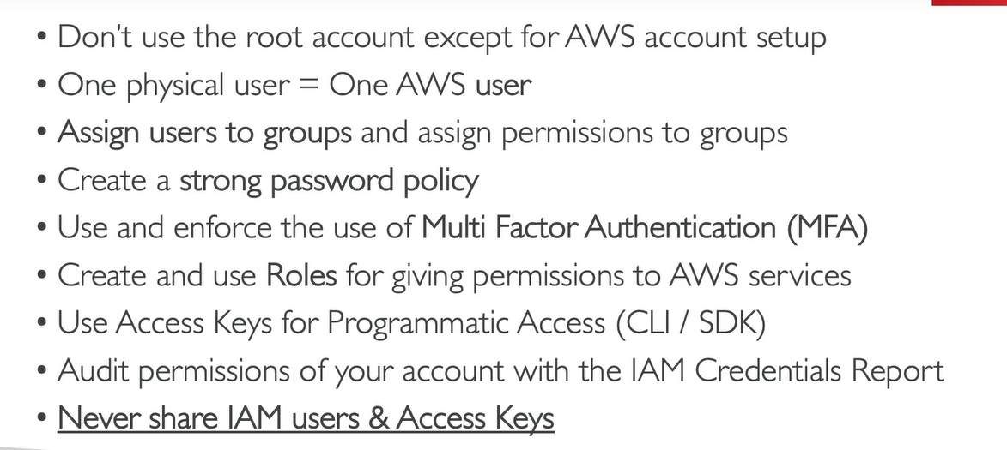
IAM Section - Summary

Slide 44
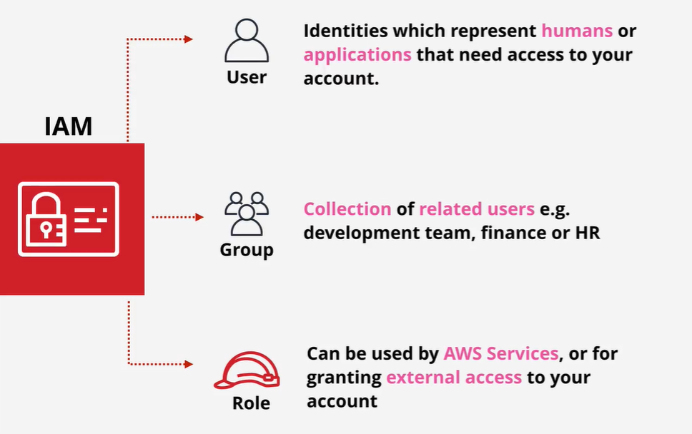

Slide 45
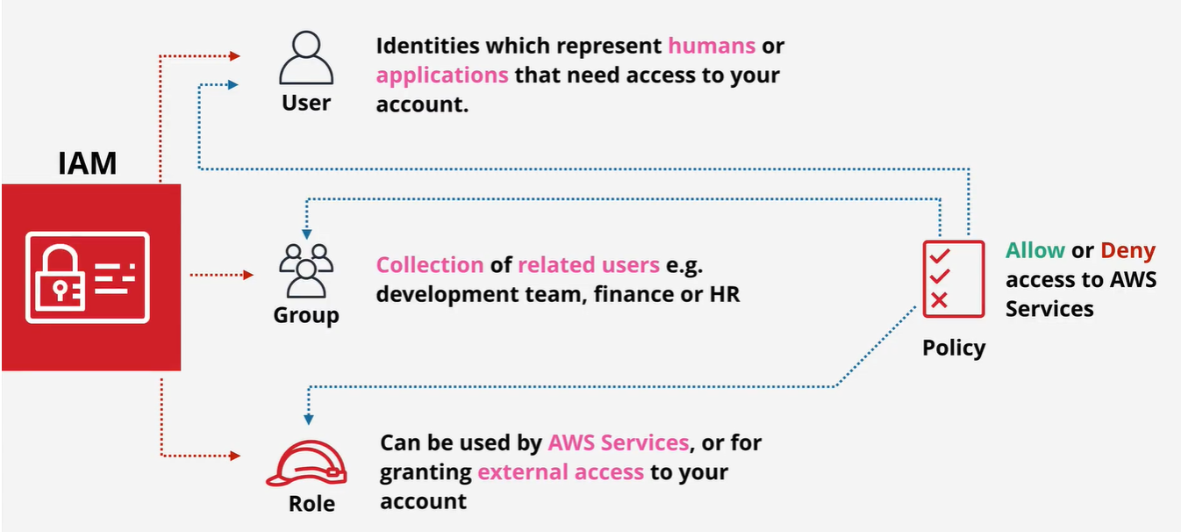

Slide 46
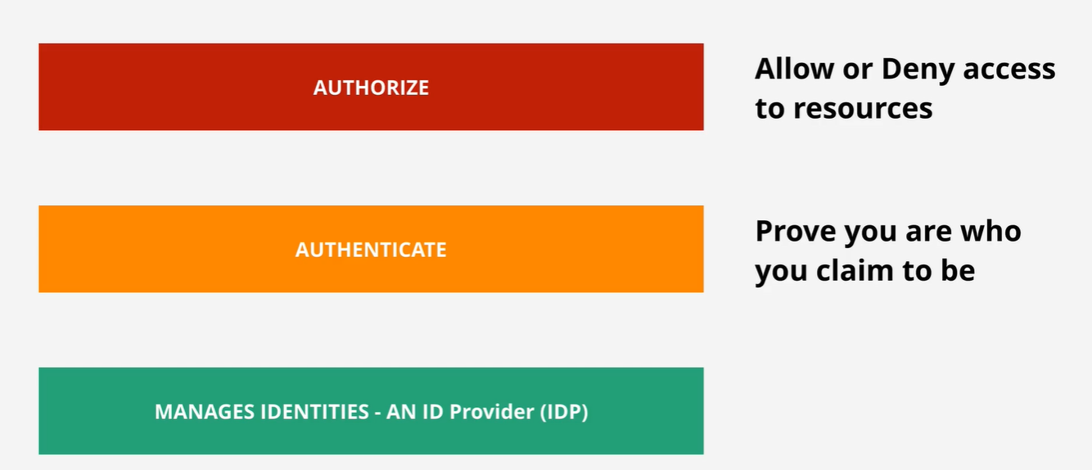

Slide 47
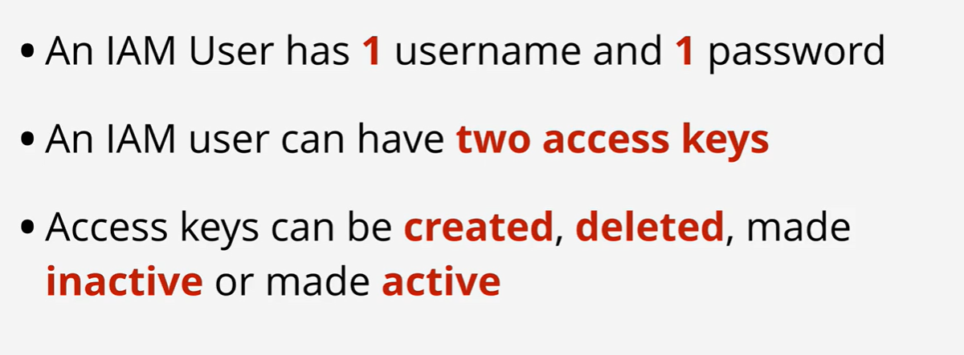

Slide 48
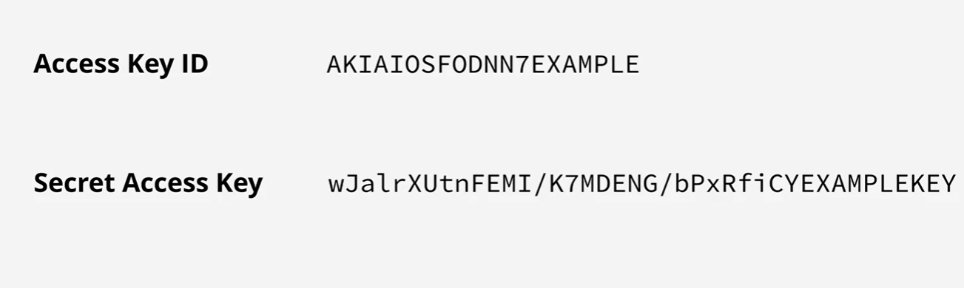

Slide 49
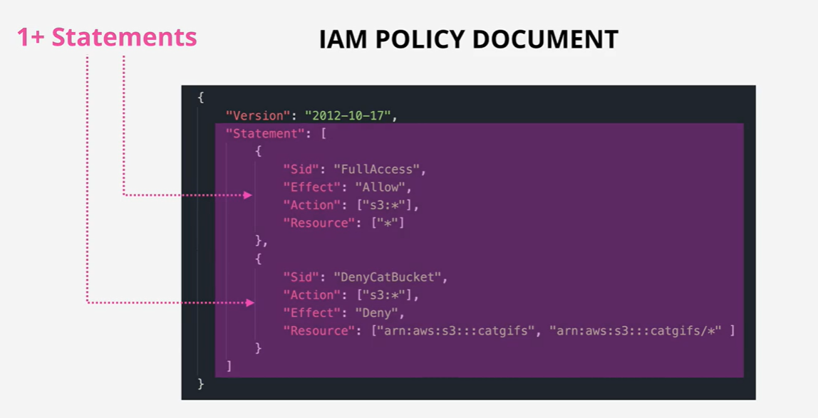
IAM Policies

Slide 50
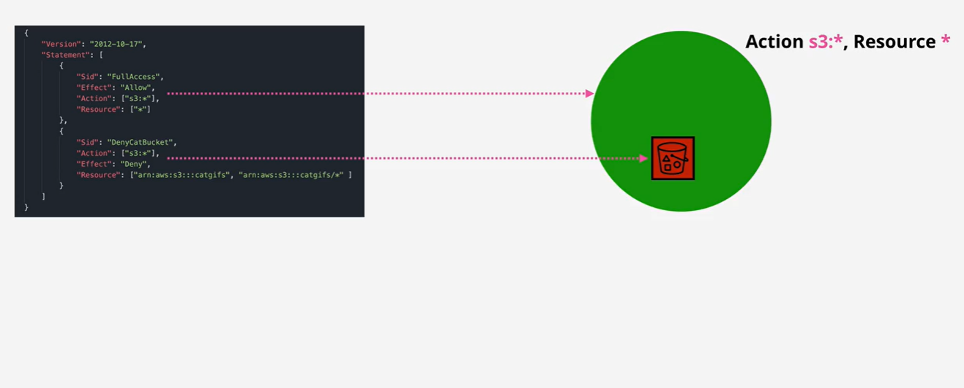

Slide 51
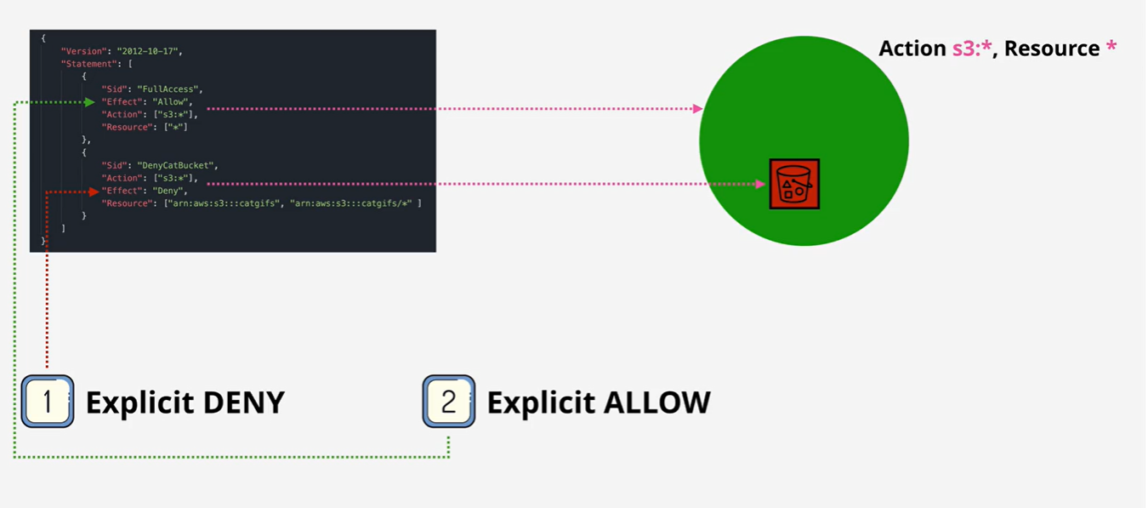

Slide 52


Slide 53
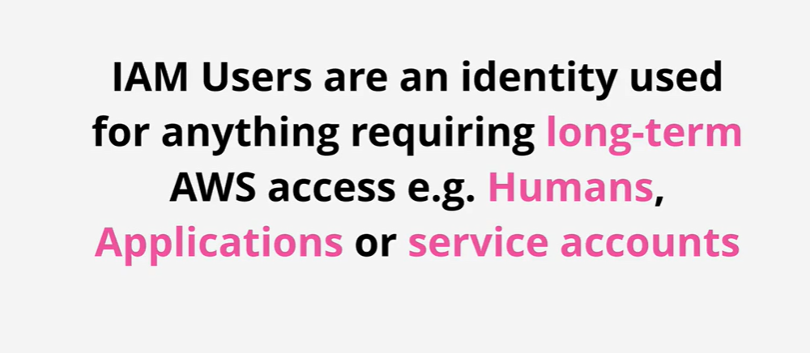
IAM Users

Slide 54
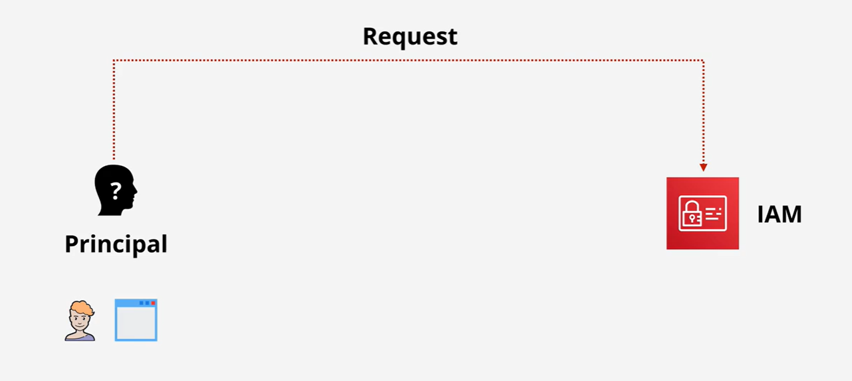

Slide 55
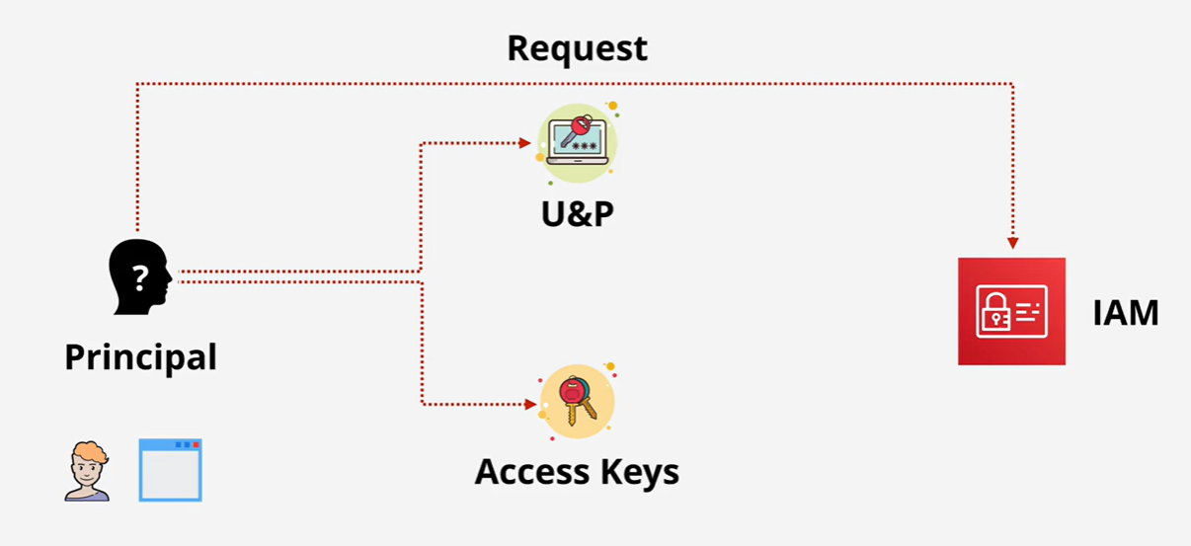

Slide 56
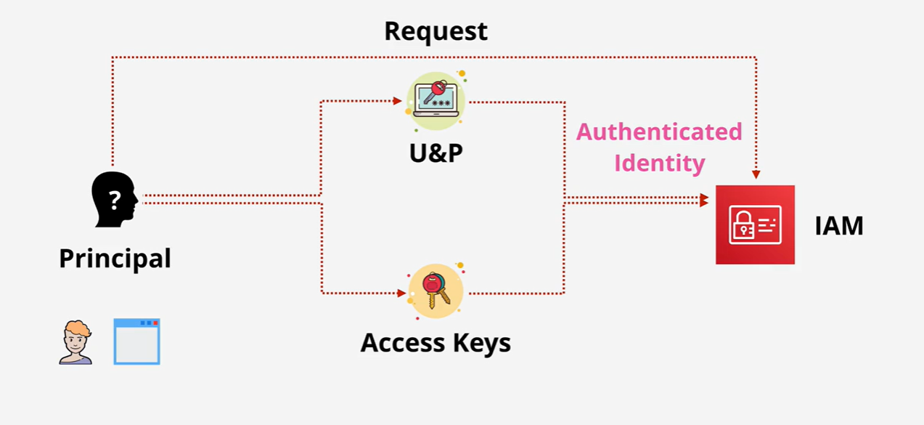

Slide 57
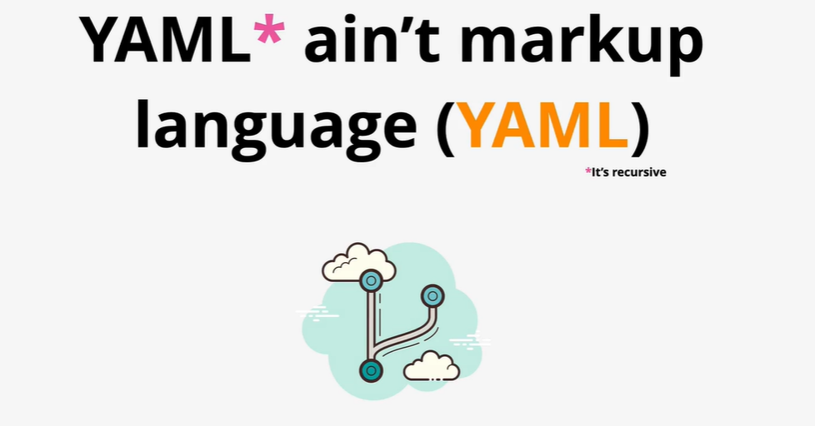

Slide 58
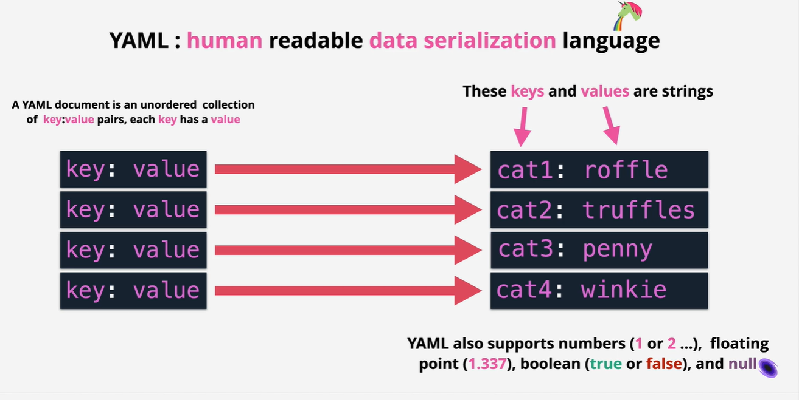

Slide 59


Slide 60


Slide 61


Slide 62


Slide 63


Slide 64


Slide 65


Slide 66


Slide 67


Slide 68


